Slide 1


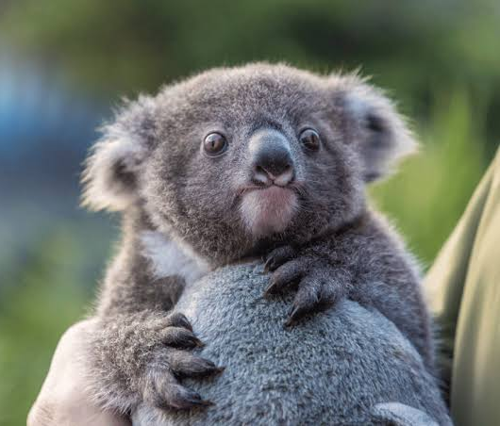

Modelling the SEQ koala distribution under current and future climate scenarios
Charlotte Patterson, QUT
Scott Forrest, QUT, CSIRO
Hello! Tell us a bit about yourselves
Mentimeter: 6816 7308

Slide 2

Acknowledgement of Traditional Owners
QUT – Turrbal and Yugara
Lands on which data were collected

Slide 3


Who are we?

Slide 4

Open-source geospatial tools for conservation under climate change - A Koala case study
Session 1 | Session 2 | Session 3 | Session 4 | Session 5
Intro to geospatial data and tools | Downscaled climate projections | Koala SDMs | Spatial conservation planning | Making maps with QGIS
Jason Flower, Mitch Rudge, Catherine Kim, EcoCommons team | Ralph Trancoso, Sarah Chapman, Rohan Eccles | Charlotte Patterson, Scott Forrest | Brooke Williams, Caitie Kuemple | Emma Hain, Nyall Dawson, Jason Flower

Slide 5
How will this workshop run?
Workshop timeline
Intro to SDMs
Climate projections
Koala ecology (relevant for SDM)
How to access the data/environmental layers
Coded example
Downloading data (koala records/environmental layers)
Environmental variable selection
Background sampling
Modelling
Prediction
Validation

Slide 6

What are we hoping you’ll get out of it?
Overview of SDMs
When might they be useful
How to prepare data and environmental layers
Brief overview of methods and algorithms
How to predict from and validate SDMs
What we won’t be providing:
Detailed insights into specific problems
Detailed reviews of different methods
We will add a to flag spots where your project would need some careful thought

Slide 7
Species Distribution Modelling 101
Relating species with environmental covariates
Niche theory

Slide 8
Data requirements
Presence-only
Occurrence/incidental records
Citizen science databases
Is it biased?
Presence-absence
Systematic surveys
Charlotte get figs from your previous presentations/paper

Slide 9
Environmental layers
Raster data representing covariates that can be used to describe an animal’s niche
Add a couple rasters

Slide 10
Models and algorithms
Models differ in their flexibility and interpretability
Generalised Linear Model (GLM)
Generalised Additive Model (GAM)
Random Forest (RF)
Maximum entropy modelling (Maxent)
Deep learning approaches
Convolutional neural networks

Slide 11
Generating predictions

Slide 12
Validating SDMs
Cross-validation (CV)
Hold out a subset of the data to test the model’s predictions against
Spatial block CV

Slide 13
Key resources
Guillera‐Arroita et al. (2015). Is my species distribution model fit for purpose? Matching data and models to applications. Global ecology and biogeography.
Guisan et al. (2017). Habitat suitability and distribution models: with applications in R. Cambridge University Press.
Araújo et al. (2019). Standards for distribution models in biodiversity assessments. Science advances.
Zurell et al. (2020). A standard protocol for reporting species distribution models. Ecography.

Slide 14
Key messages
Modelling is often more art than science
We make many decisions along the way
We need to be transparent and clear about these decisions
We need to spend time understanding the effect of our decisions

Slide 15
Getting started – some questions to ask yourself
What is the aim of my model?
Explanation
Mapping
Transfer
Araújo et al. (2019). Standards for distribution models in biodiversity assessments. Science advances.

Slide 16
Getting started – some questions to ask yourself
What are my model outputs going to be used for?
Describing the species’ distribution
Making colourful maps
Spatial prioritisation
Guillera‐Arroita et al. (2015). Is my species distribution model fit for purpose? Matching data and models to applications. Global ecology and biogeography.

Slide 17

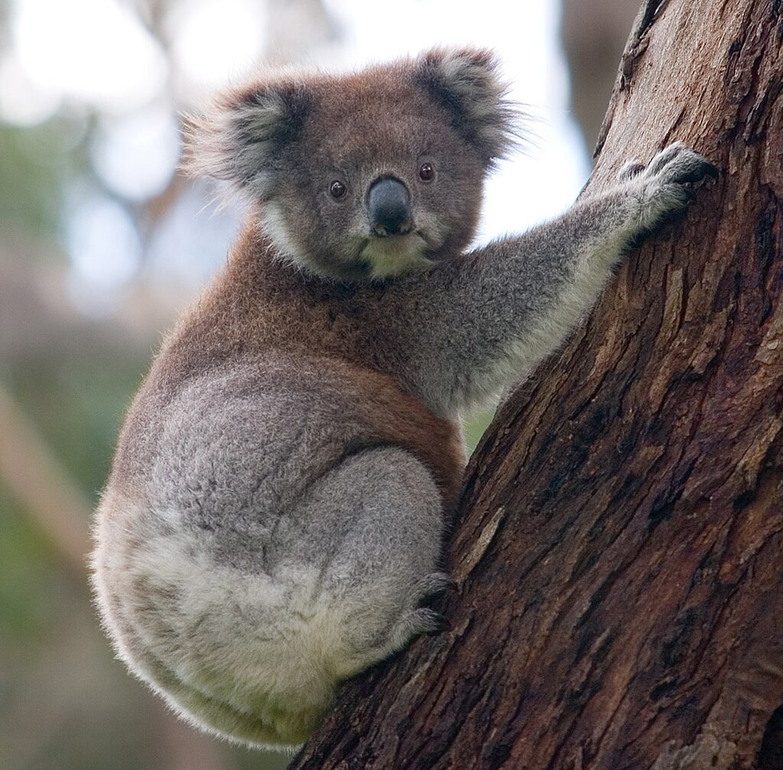
Koala (Phascolarctos cinereus)
The word "koala" comes from the Dharug gula, meaning 'no water’
Phaskolos = pouch, arktos = bear (Greek)
Cinereus = ash coloured (Latin)
Found in open forest and woodland
Dependent on specific feeding trees*
~ 30 species of Eucalyptus
Sensitive to land use change
Photo by DAVID ILIFF. License: https://creativecommons.org/licenses/by-sa/3.0/

Slide 18
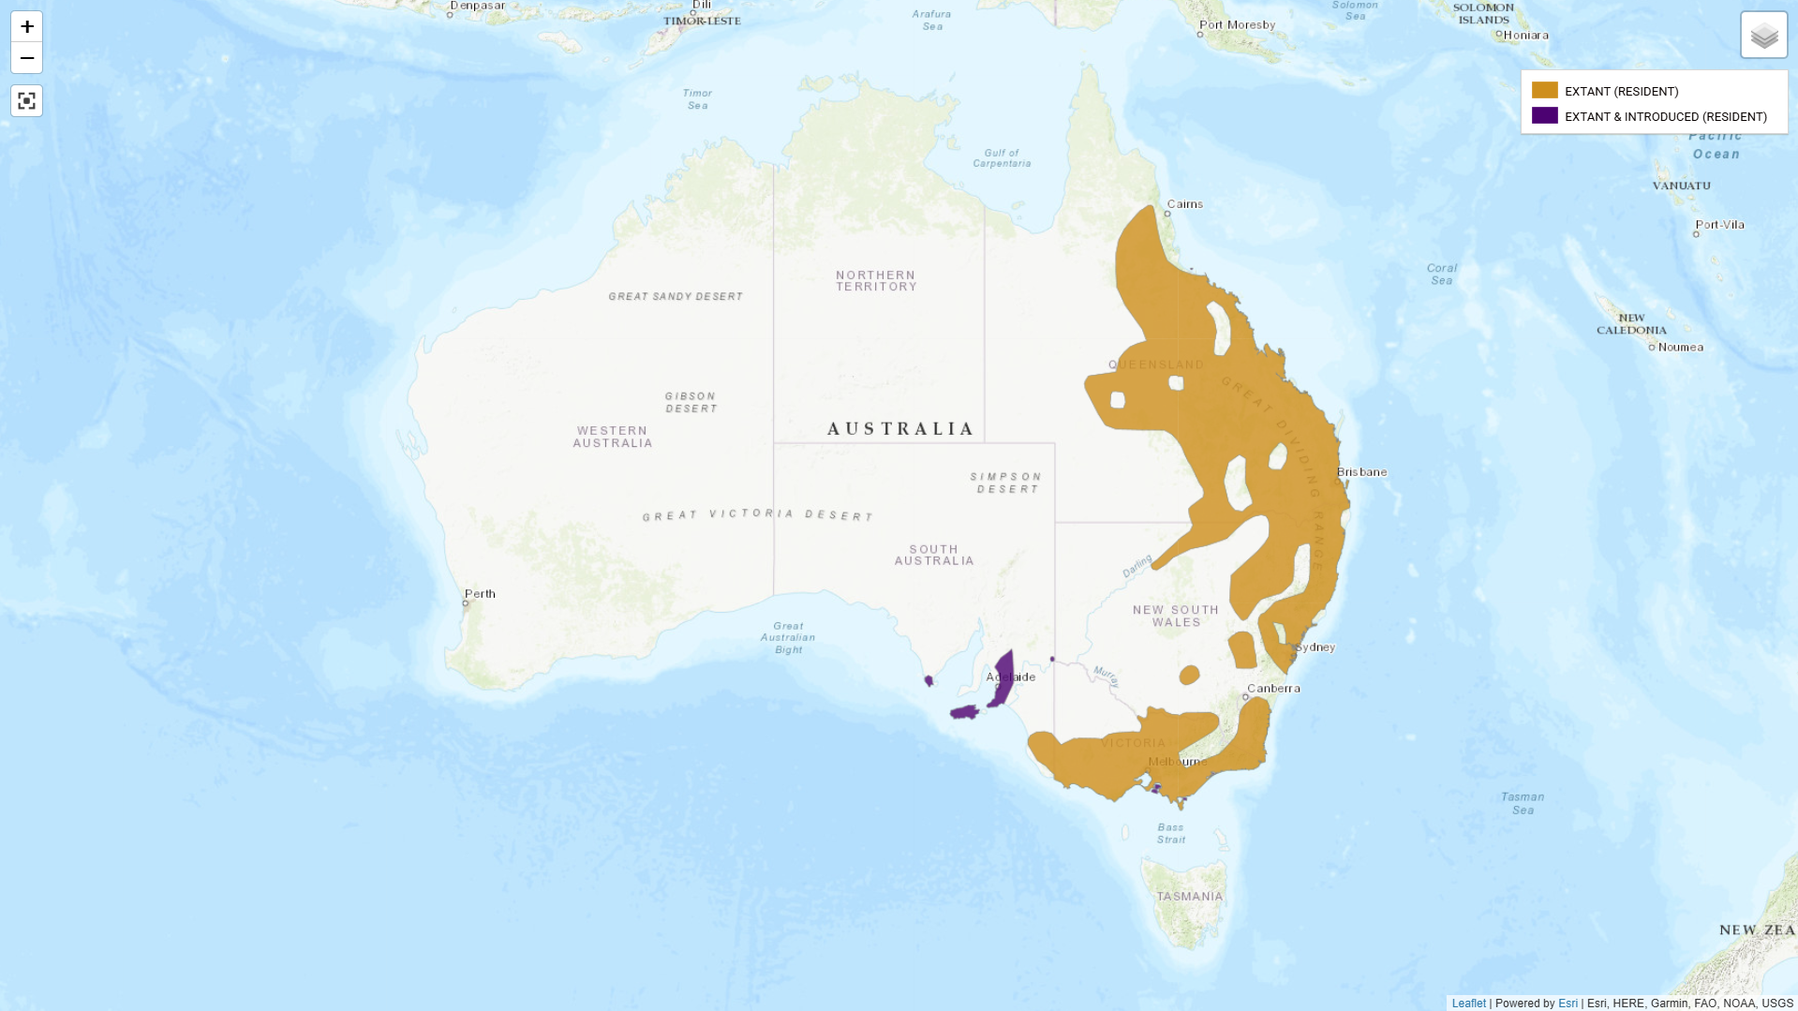

Slide 19
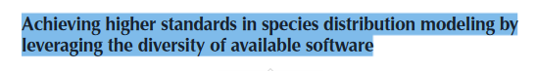
There are many tools out there…

Slide 20
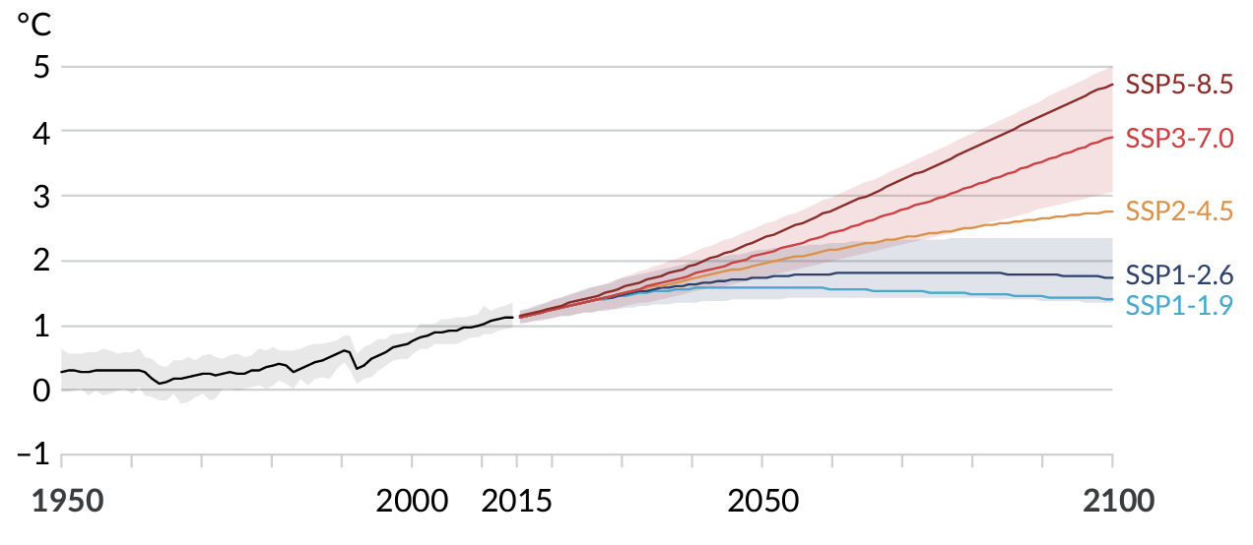
Climate projections
Current
2050
2070
2090
Global surface temperature change relative to 1850-1900. Projected global average surface temperature change in each of the five SSP scenarios. Source: IPCC

Slide 21
BIOCLIM Layers
BIO1 = Annual Mean Temperature
BIO2 = Mean Diurnal Range (Mean of monthly (max temp - min temp))
BIO3 = Isothermality (BIO2/BIO7) (×100)
BIO4 = Temperature Seasonality (standard deviation ×100)
BIO5 = Max Temperature of Warmest Month
BIO6 = Min Temperature of Coldest Month
BIO7 = Temperature Annual Range (BIO5-BIO6)
BIO8 = Mean Temperature of Wettest Quarter
BIO9 = Mean Temperature of Driest Quarter
BIO10 = Mean Temperature of Warmest Quarter
BIO11 = Mean Temperature of Coldest Quarter
BIO12 = Annual Precipitation
BIO13 = Precipitation of Wettest Month
BIO14 = Precipitation of Driest Month
BIO15 = Precipitation Seasonality (Coefficient of Variation)
BIO16 = Precipitation of Wettest Quarter
BIO17 = Precipitation of Driest Quarter
BIO18 = Precipitation of Warmest Quarter
BIO19 = Precipitation of Coldest Quarter

Slide 22
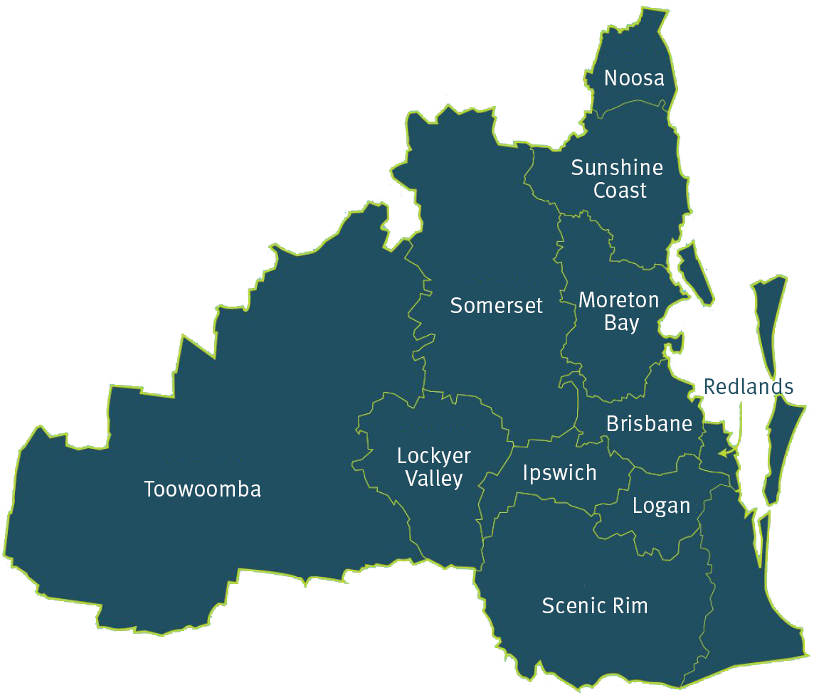
Study region – South-East Queensland
Notes:
Selecting a study domain – often should be determined by biology. But can instead be pragmatic

Slide 23
Environmental covariate selection
Step 1. Expert consultation
Step 2. Correlation checks
Step 3. Model selection

